Slide 1

Linkedin Data Job Analysis
Impana P
July 2025

Slide 2

Introduction
This project analyzes LinkedIn job listings posted on March 31, 2023.
Focus is on India-based data roles: Data Analyst, BI Analyst, etc.
Helps job seekers, students, and recruiters understand the hiring landscape.

Slide 3

Objective
Understanding job market dynamics on LinkedIn.
Identify top hiring companies, locations, and industries.
Determine the most in-demand job types, skills, and seniority levels.
Provide insights for career planning and recruitment strategy.

Slide 4

Problem Statement
Lack of clear visibility into where and how data jobs are growing.
Job seekers are unaware of trending skills, cities, or industries.
Companies struggle to benchmark their hiring patterns.

Slide 5

Methodology
Web-scraped LinkedIn dataset with 1100+ job listings.
Cleaned, structured, and visualized data using Python (Pandas, Matplotlib, Seaborn).
Extracted insights via graphs and distributions.

Slide 6
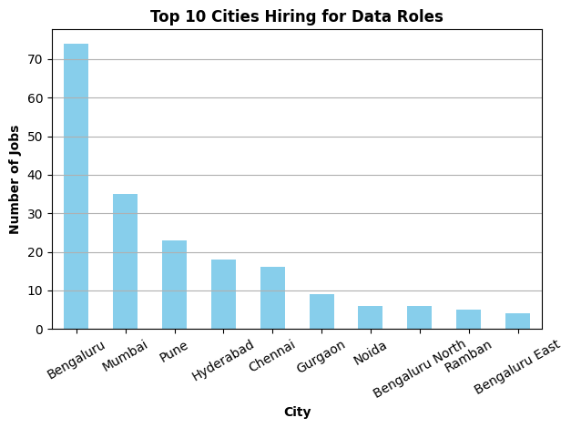
Top Hiring Cities
Bengaluru leads by a large margin, followed by Mumbai and Pune.
Southern metros dominate the list, reflecting strong tech presence.
Tier-2 cities show limited data on job openings.

Slide 7
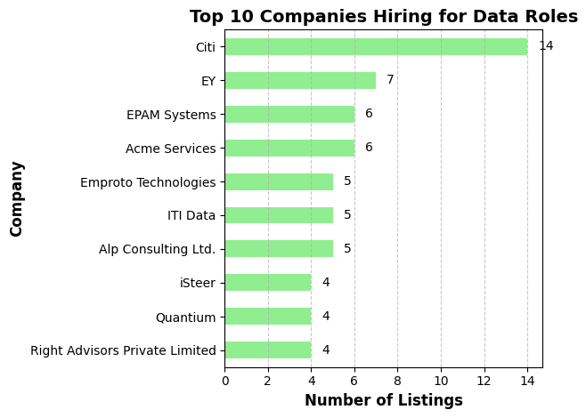
Top Hiring Companies
Citi tops the list with the highest number of openings.
Consulting and tech firms dominate hiring.
Listings are spread across both global and Indian firms.

Slide 8
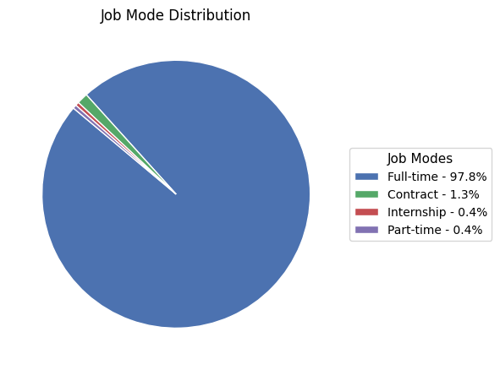
Job Type Distribution
Over 97% of jobs are Full-Time roles.
Contract, internship, and part-time roles are rare.
Highlights long-term hiring trend on LinkedIn.

Slide 9
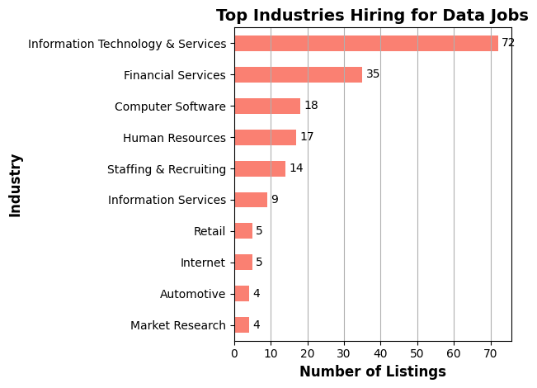
Industry-Wise Demand
IT & Financial Services together account for over 100 listings.
Strong demand from tech, finance, and HR sectors.
Data roles are spread across both traditional and emerging industries.

Slide 10
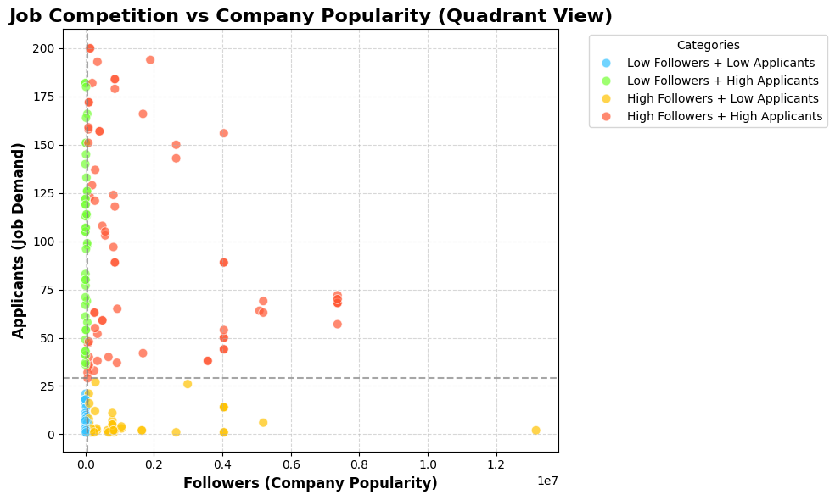
Followers vs Applicants
Most companies fall in 'High Followers + High Applicants' category.
Few companies are highly followed but less applied to.
Data reveals competitive hotspots for job seekers.

Slide 11
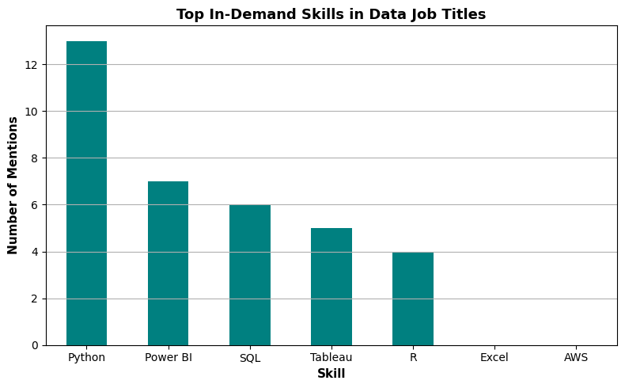
Top In-Demand Skills
Python appears most frequently in job titles.
BI tools like Power BI and Tableau are also key.
Emphasizes the need for strong technical foundations in analytics roles.

Slide 12
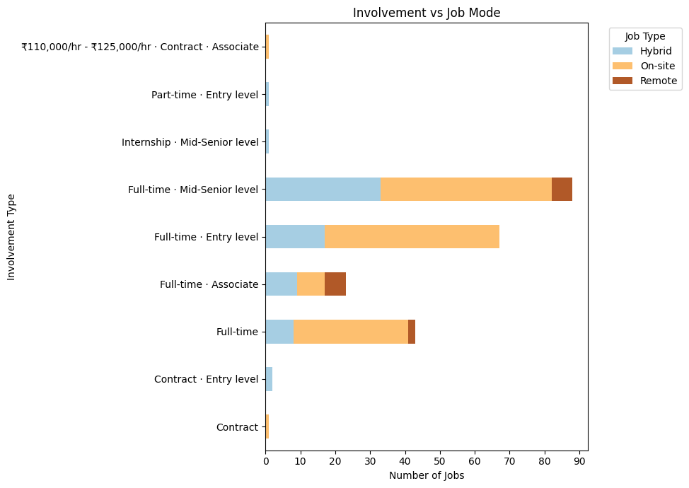
Involvement vs Job Mode
Most jobs are full-time and on-site.
Hybrid and remote roles are few, mostly in mid-senior positions.
Entry and associate-level roles are primarily on-site.

Slide 13
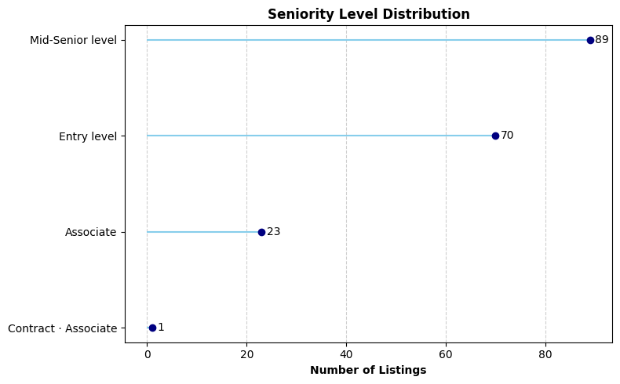
Seniority Level Distribution
Mid-Senior level has the highest number of openings.
Entry-level roles follow closely, showing balance in experience demand.
Associate-level positions are fewer in comparison.

Slide 14
Final Conclusions
Most data jobs are concentrated in major metros like Bengaluru, Mumbai, and Pune.
Full-time roles dominate the market; internships and part-time roles are minimal.
Multinational companies and tech-focused firms lead hiring.
Job seekers should focus on upskilling in tools like Power BI, SQL, and Python to stay competitive.

Slide 15
Thank you
Impana P
impana.panu@gmail.com
www.linkedin.com/in/impana-p-011131260

